Slide 1

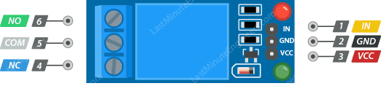
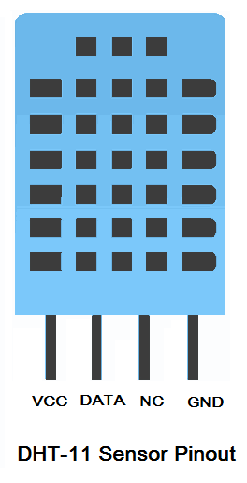
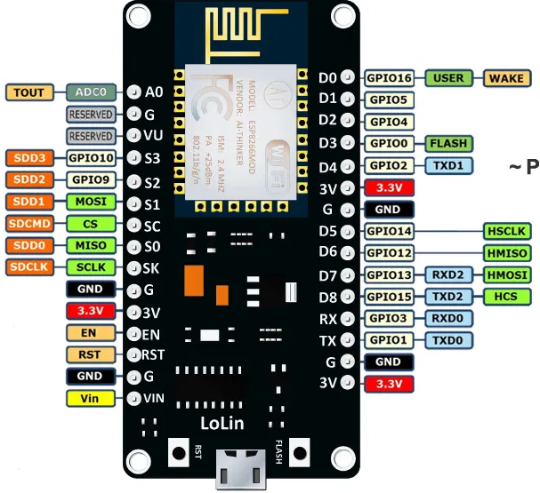
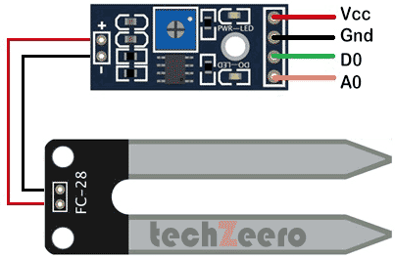
# Blynk Virtual pins:
# V16 = Output, switch Pump status: ON or OFF = D5 (output GPIO14)
# V0 = Input, Status, Power is ON LED = D7 (output GPIO13)
# V1 = Input, Status, Wifi is ON LED = D6 (output GPIO12)
# V2 = Input, Status, Pump is set ON or OFF = D0 (input, GPIO16 Connect to D5 GPIO14)
# V10 = Input, Air Temperature (temp) = D2 (input GPIO4)
# V11 = Input, Air Humidity (hum) = D2 (input GPIO4)
# V12 = Input, Soil Moisture (moi) = A0 (input ADC0)
# V13 = Output, Master RESET (Disabled)
# V20 = Output, Enter Password to Reset the Machine
Ver 15 Jun 2021
GND
1k
Vcc = 3.3V, ADC0 input max 3.3V
Update ON
3.3 V
(NC)
10k
5 V
Reset
o o
Power On
Wifi ON
Pump ON
GND
1k
1k
1k
GND

Slide 2
